Slide 1
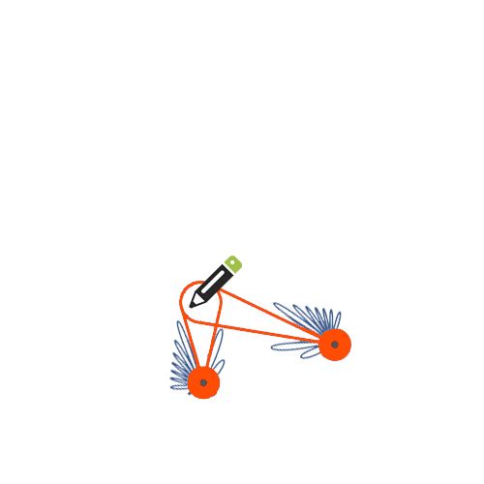
mTrack: High-Precision Passive Tracking Using Millimeter Wave Radios
Teng Wei and Xinyu Zhang
University of Wisconsin – Madison

Slide 2
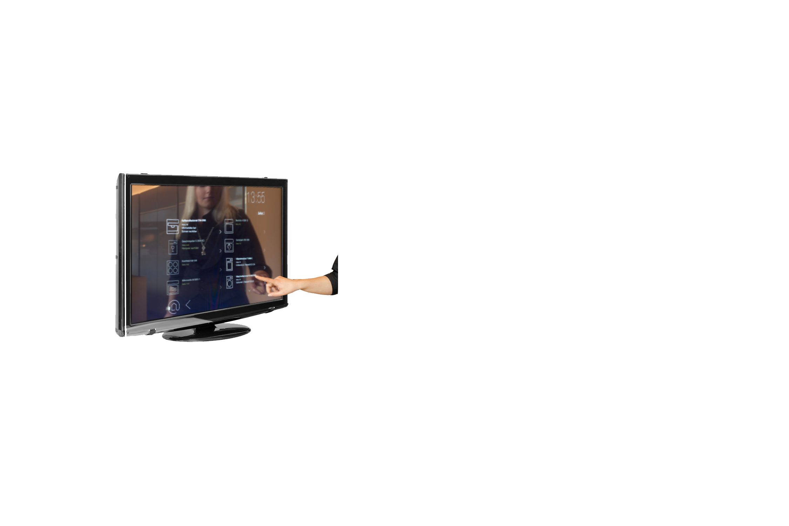
Near-field Wireless Tracking
Tracking objectives at mm-level accuracy
Virtual Trackpad
Interactive Display
Tracking Whiteboard
Turn any surface into interactive virtual touchscreen
Enable a new form of pervasive user-computer interface

Slide 3
State-of-the Art
Radio-based tracking system
Active
PinLoc
MobiSys
H.Fang, 60GHz RSS Localization with Omni-directional and Horn Antennas, Ph.D. dissertation, 2010.
RF-IDraw
SIGCOMM
Tagoram
MobiCom
Passive
C. Xu, etalSCPL: Indoor Device-free Multi-subject Counting and Localization Using Radio Signal Strength IEEE IPSN, 2013.
WiVi
SIGCOMM
WiTrack
NSDI
?
m-level dm-level cm-level mm-level

Slide 4
New Challenges
Passive Fine-grained Tracking
Weak signal intensity of passive reflection
Target does not modulate and emit signals
Especially from small objects, like pen
Irrelevant reflection from unintended objectives
Time-varying multipath reflection from background
Locating initial position with few number of devices
Costly to deploy substantial nodes

Slide 5
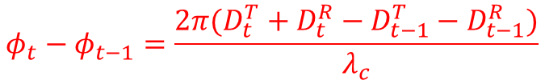
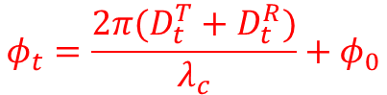
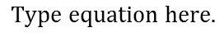
Overview the Basic Idea
Rx2
$$φ_{t}=\frac{2π(D_{t}^{T}+D_{t}^{R})}{λ_{c}}+φ_{0}$$
Tx
$$φ_{t}−φ_{t−1}=\frac{2π(D_{t}^{T}+D_{t}^{R}−D_{t−1}^{T}−D_{t−1}^{R})}{λ_{c}}$$
Pen
Rx
❶
60GHz laser-like directional beam
❷
Flexible beam-steering capability
❸
5mm extremely short wavelength
❹
Interactive diffusion from small objects
❺
Quasi-omni-directional illumination

Slide 6
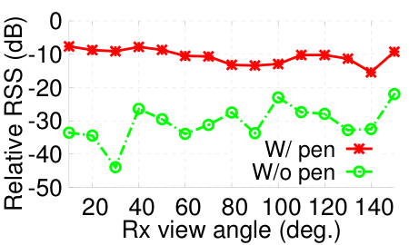
Understanding mmWave Passive Tracking
Feasibility Study
Diffusive Reflection
30cm
15~20dB
Pen 0.8cm
Tx
Rx
Fine-grained Tracking
60cm
50cm
Tx
Moving
Rx
Initial Locating
50cm
Tx
Rx

Slide 7
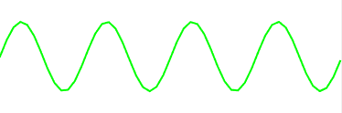
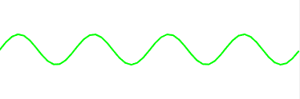
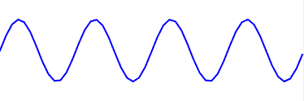
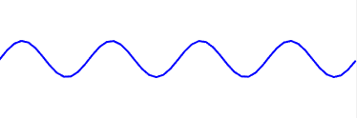

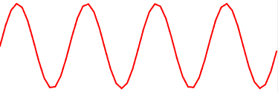
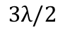


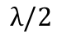
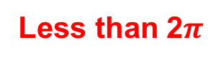
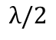
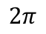
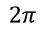
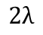


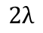
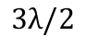
Key Challenge: Background Reflection
Target Dominated
Target Reflection
Background Reflection
Background Dominated
Objects in
the background
Tx
Rx
Rx
Target Dominated
Background Dominated
$$2π$$
$$2π$$
Phase of
Received
Signal
Phase of
Received
Signal
Less than 2$π$
$$0$$
$$0$$
$$λ/2$$
$$λ$$
$$3λ/2$$
$$2λ$$
$$λ/2$$
$$λ$$
$$3λ/2$$
$$2λ$$
Target movement
Target movement

Slide 8

Naïve Solution
Filter the received waveform (RFID)
Unmodulated
Require target to modulate the reflect signal
Modulated
1, 0, 1, 0, …
DC-filter the decoded symbols
Received signal
Q
Target
reflection
Q
I
Background
reflection
I
static background removed

Slide 9
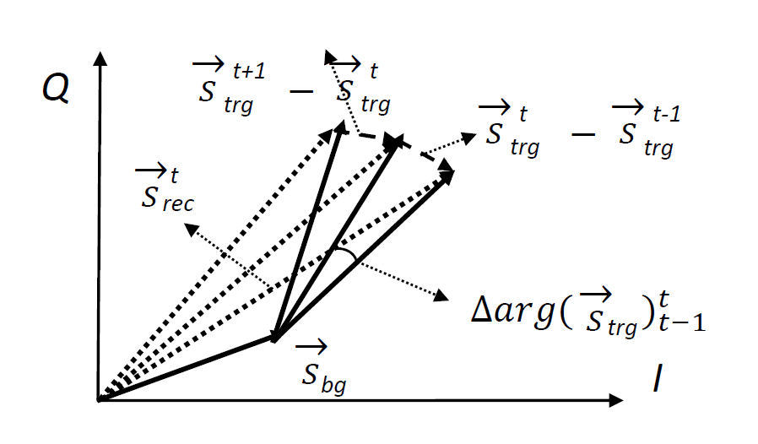

Slide 10

Dual-differential Background Removal (DDBR)
Key Observation
Background reflection remains similar in consecutive samples
Differential cancels the background reflection
Lemma (DDBR): The average phase shift among three consecutive samples is
Sample differential
DDBR
received signals
$$\frac{1}{2}[{Δarg({\vec{S}}_{trg})}_{t−1}^{t}+{Δarg({\vec{S}}_{trg})}_{t}^{t+1}]=arg\left({\vec{S}}_{rec}^{t+1}−{\vec{S}}_{rec}^{t}\right)−arg\left({\vec{S}}_{rec}^{t}−{\vec{S}}_{rec}^{t−1}\right)$$
5
3
1
-1
-3
-4
Phase
Average phase shift
Diff. phase of sample differential
Target movement

Slide 11
Advantage and Limitation
Pros of DDBR
Handle time-varying background reflection
Simple computation of processing
Suitable for hardware implementation
Cons of DDBR
Vulnerable to the phase noise
60GHz COTS device has non-negligible phase noise
phase noise > phase shift

Slide 12
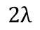
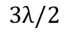

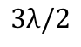

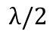

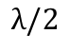
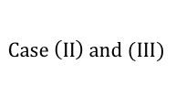
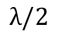

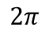
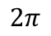
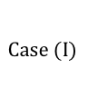

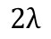
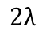
Phase Counting and Regeneration (PCR)
Periodicity Pattern of Phase
I (TD)
II (BD)
III (ITM)
$$2π$$
$$2π$$
$$2π$$
Phase
Phase
Phase
$$0$$
$$0$$
$$0$$
$$λ/2$$
$$λ$$
$$3λ/2$$
$$2λ$$
$$λ/2$$
$$λ$$
$$3λ/2$$
$$2λ$$
$$λ/2$$
$$λ$$
$$3λ/2$$
$$2λ$$
Target movement
Target movement
Target movement
PCR Algorithm
Step 1
$$Case (I)$$
$$Case \left(II\right) and (III)$$
$$Case (I)$$
Reducing ITM to BD
Input phase
3
0
-3
3
0
-5
Step 2
Periodicity Counting
1
0
3
0
-3
Step 3
Regeneration
0 50 100 150 200 250 300 350
Sample index

Slide 13
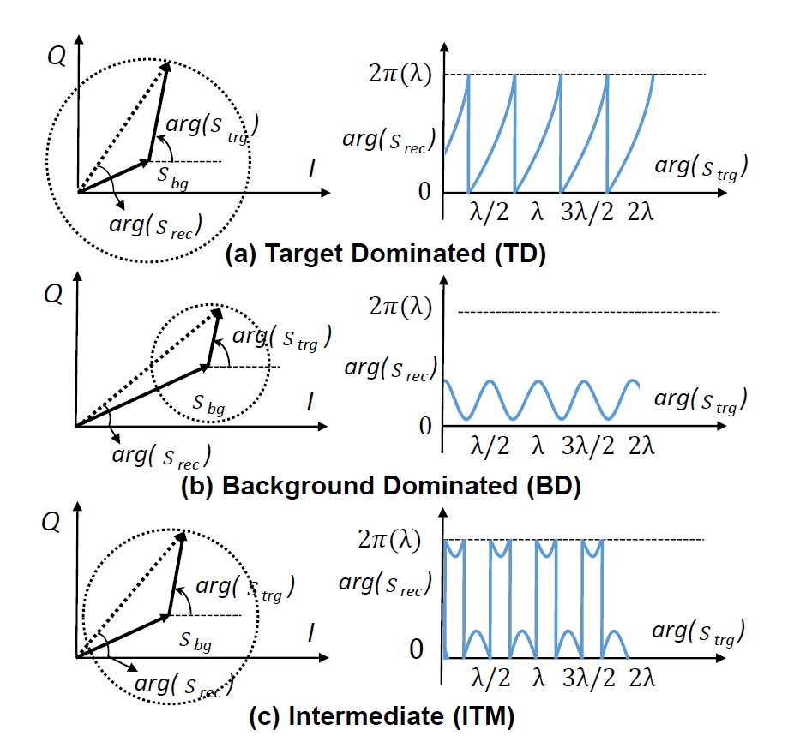

Slide 14
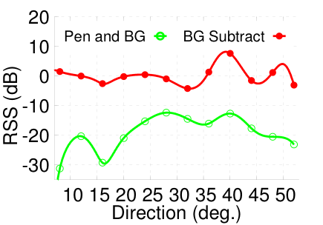
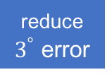
Anchor Point Acquisition (APA)
Complementary to Tracking
Initial location for successive tracking
Calibrate tracking result
Prevent error accumulation
Discrete Beam Steering
Background Reflection
True direction
reduce $3^{°}$ error
BG
Pen
Enhance 10dB contrast
Spline interpolation improves granularity of APA
RSS subtraction improves contrast of APA

Slide 15
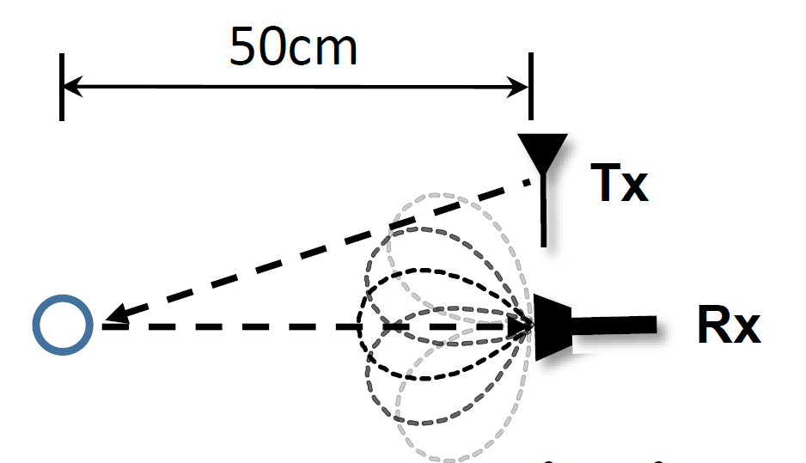

Slide 16
Touch Event Detection
Detect touch gestures as control command
e.g., start/pause of tracking
Gesture and Feature Space
Touch
❶
Phase shift
❷
Variance of phase shift
❸
Click
Lift
RSS
$$Touch$$
$$Lift$$
$$Click$$
Decision tree rule
Event detection: Variance of phase shift
Event Classification: RSS

Slide 17
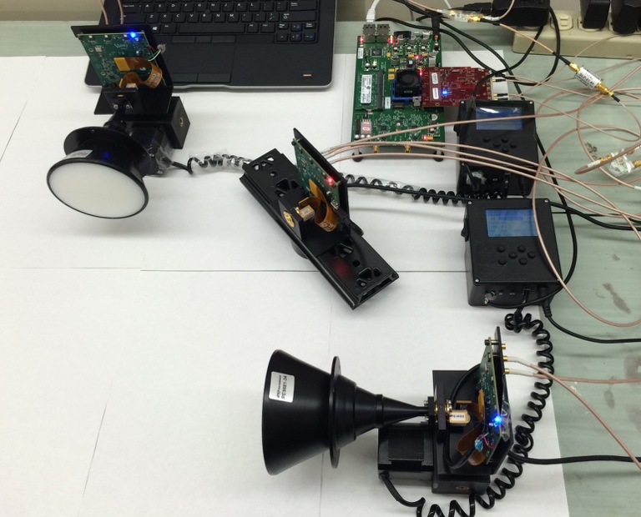



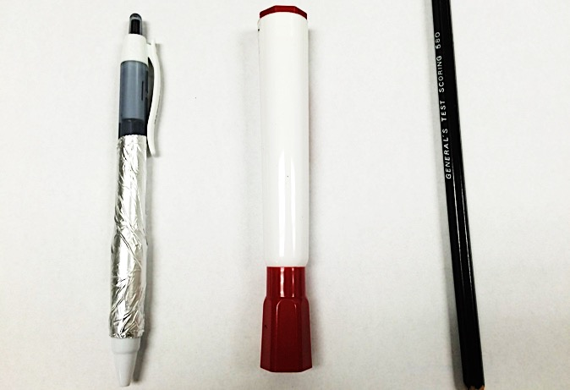
Implementation and Evaluation
High Speed
ADC/DAC
WARP Board
60 GHz RF
Front-end (Rx)
Tracking
Horn Antenna
PHY Extraction
Locating
Touch detection
mTrack
Apps
Motorized
Rotator
60GHz SDR testbed
Algorithm implementation
Testing objects
Metal-surfaced pen
Marker
Pencil

Slide 18
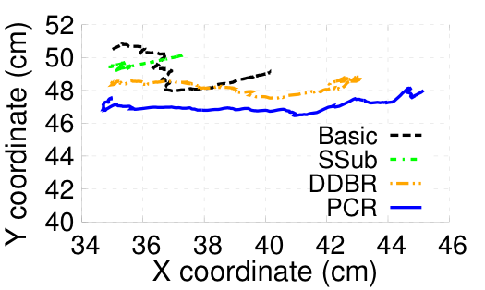
Passive Tracking
Tracking Setup
Result
Rx 1
Drywall
Tx
Rx 2
2m
10cm
10cm
Example trajectory of tracking
1m⨉1m
1.5m
Cabinet
1cm
Achieve high-precision tracking
3cm
Error map over tracking region

Slide 19
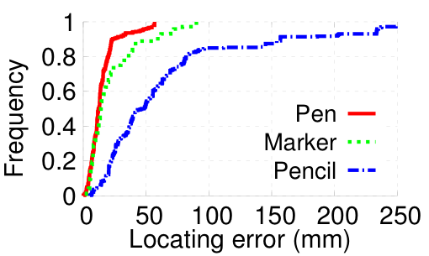

Anchor Positioning and Event Detection
APA Performance
Randomly placed 30 positions
Beam-steering at step of $8^{°}$
Average error of 1.5 cm, 2 cm and 6 cm
RSS: 12.3dB, 10.1dB and 4.7dB
Event Detection
7 users
Event | Touch | Lift | Click | ND
Touch | 94.0% | 0 | 0 | 6.0%
Lift | 0 | 93.5% | 0 | 6.5%
Click | 0 | 0 | 94.8% | 5.2%
Each provides a 10-sample training set
20~50-sample testing set

Slide 20
Application: Trackpad
Experiment Setup
Integrate mTrack into word-recognition application
Record hand-writing trace from mTrack
Export and control mouse of a PC
MyScript© Stylus for word detection
Example word
Recognition Accuracy

Slide 21
Conclusion
First RF-based system that achieves sub-centimeter scale passive object tracking
Resolve new practical challenges in passive tracking/locating
DDBR algorithm for addressing background reflection
PCR algorithm for mitigating phase noise issue
RSS interpolation and subtraction for improving granularity and contrast.
Implement on a configurable 60GHz radio testbed
Validate performance in a wireless trackpad setup

Slide 22
Questions?
Thank you

